Slide 1
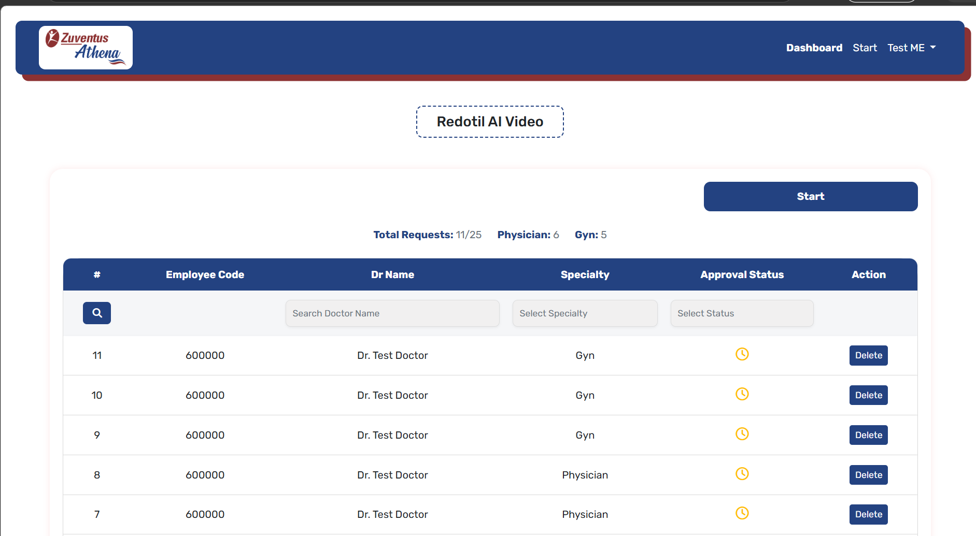

remove

Slide 2
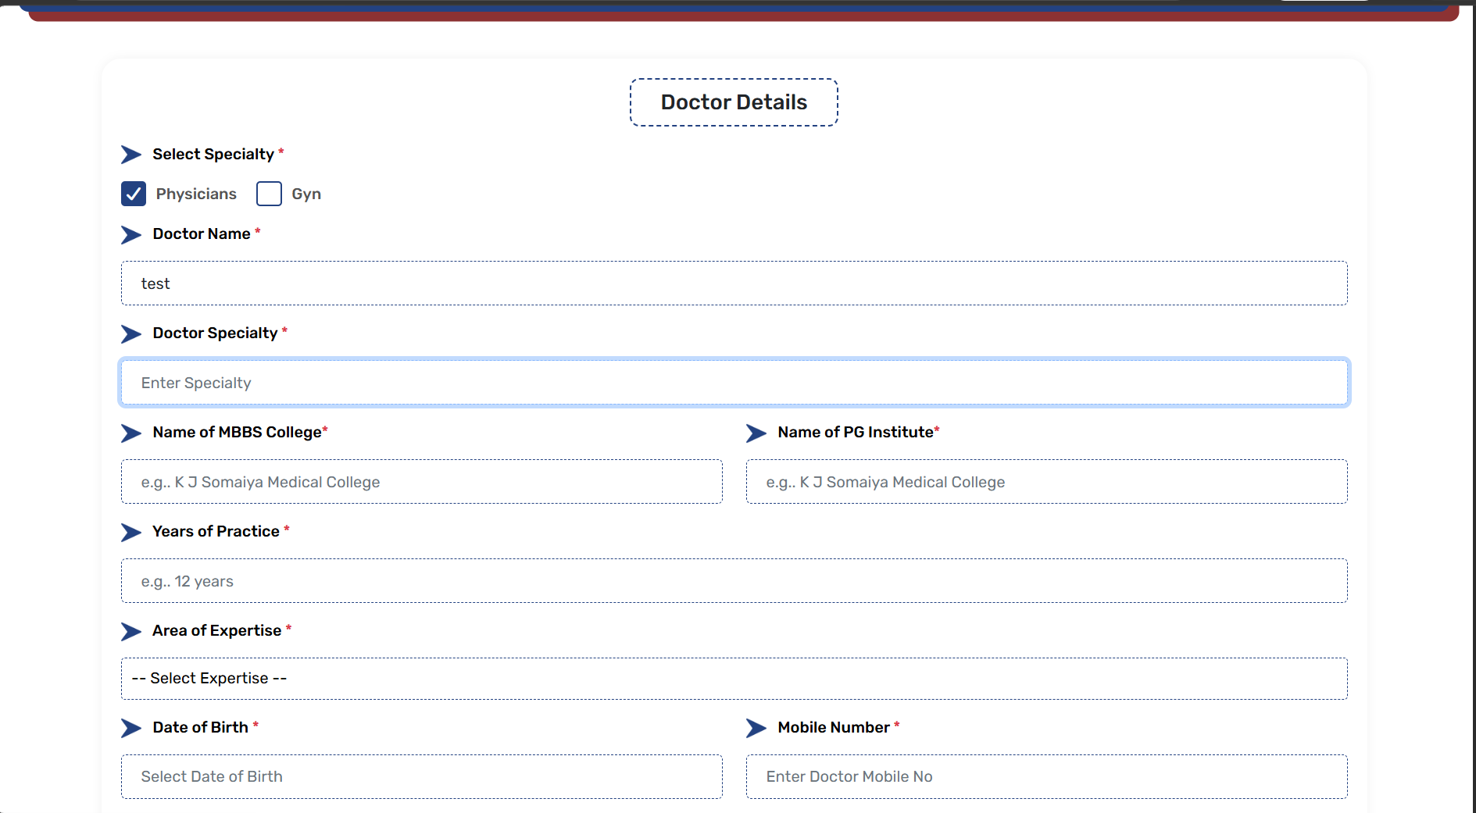
UID No:
(Please verify doctor’s spelling)
City of MBBS College
City of PG Institute

Slide 3
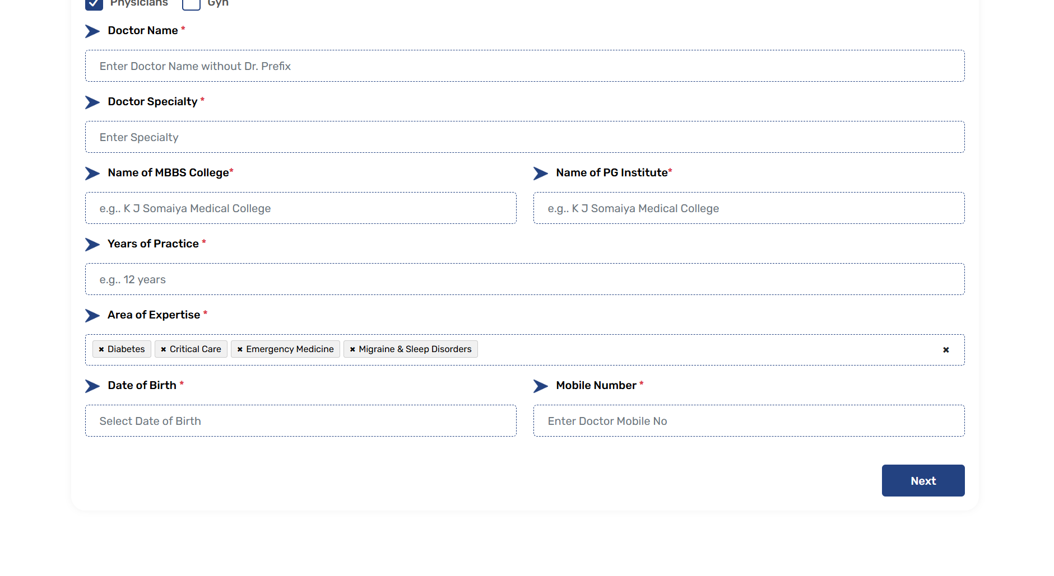
(You can select multiple areas of expertise)
Can we give option for only date and month

Slide 4
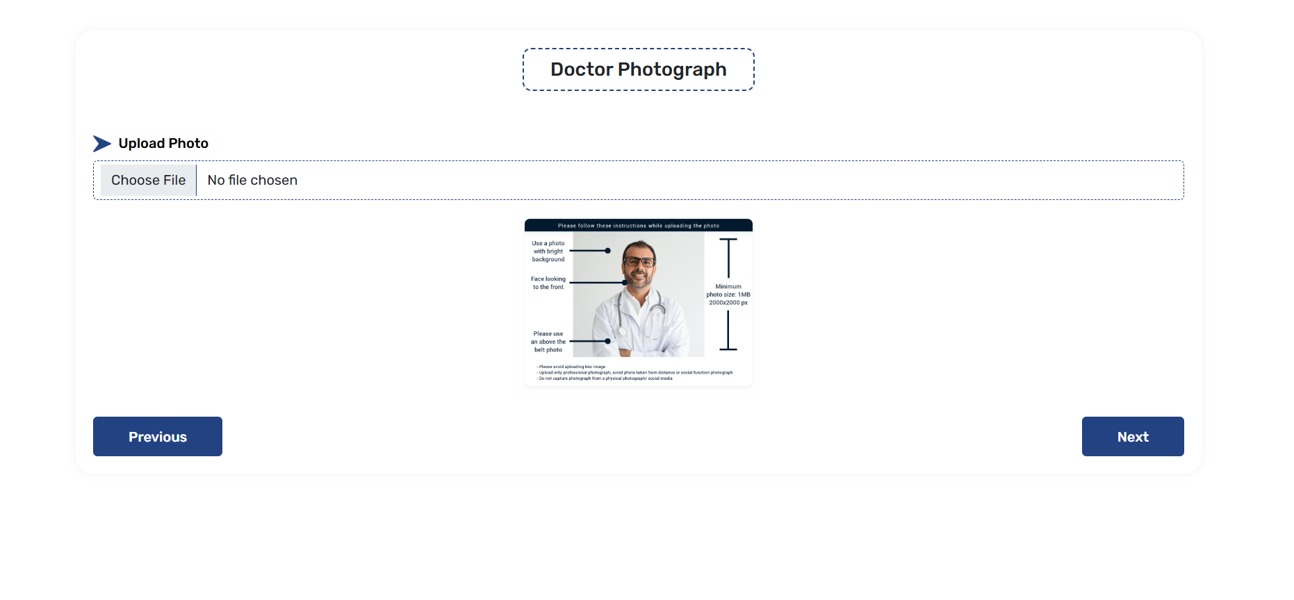
(Please add doctor image above 1 MB and upload doctor image with clear background)

Slide 5
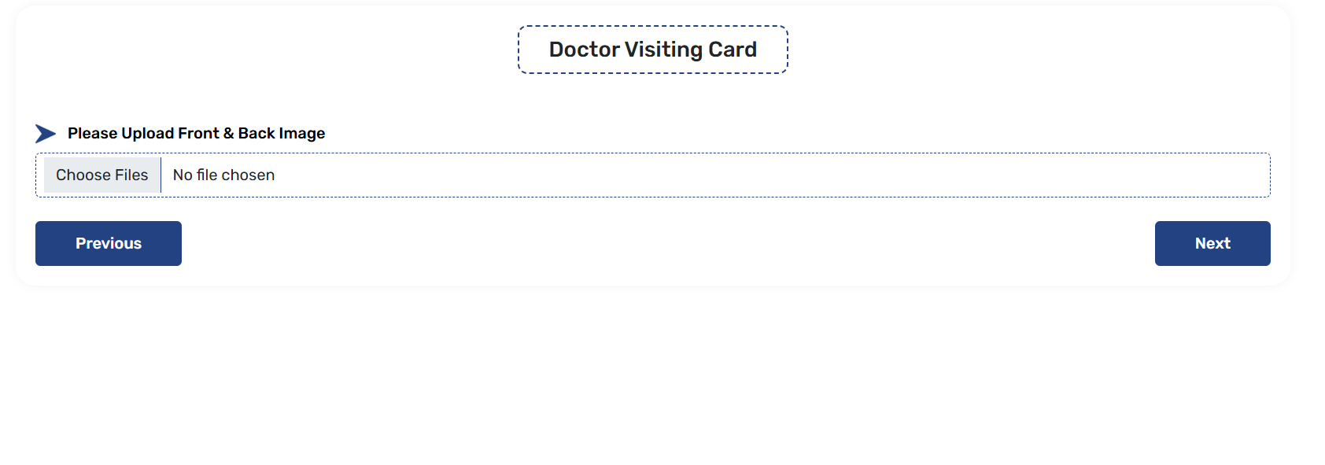
Upload Doctor Visiting Card/ Prescription Pad/ Letter Head

Slide 6
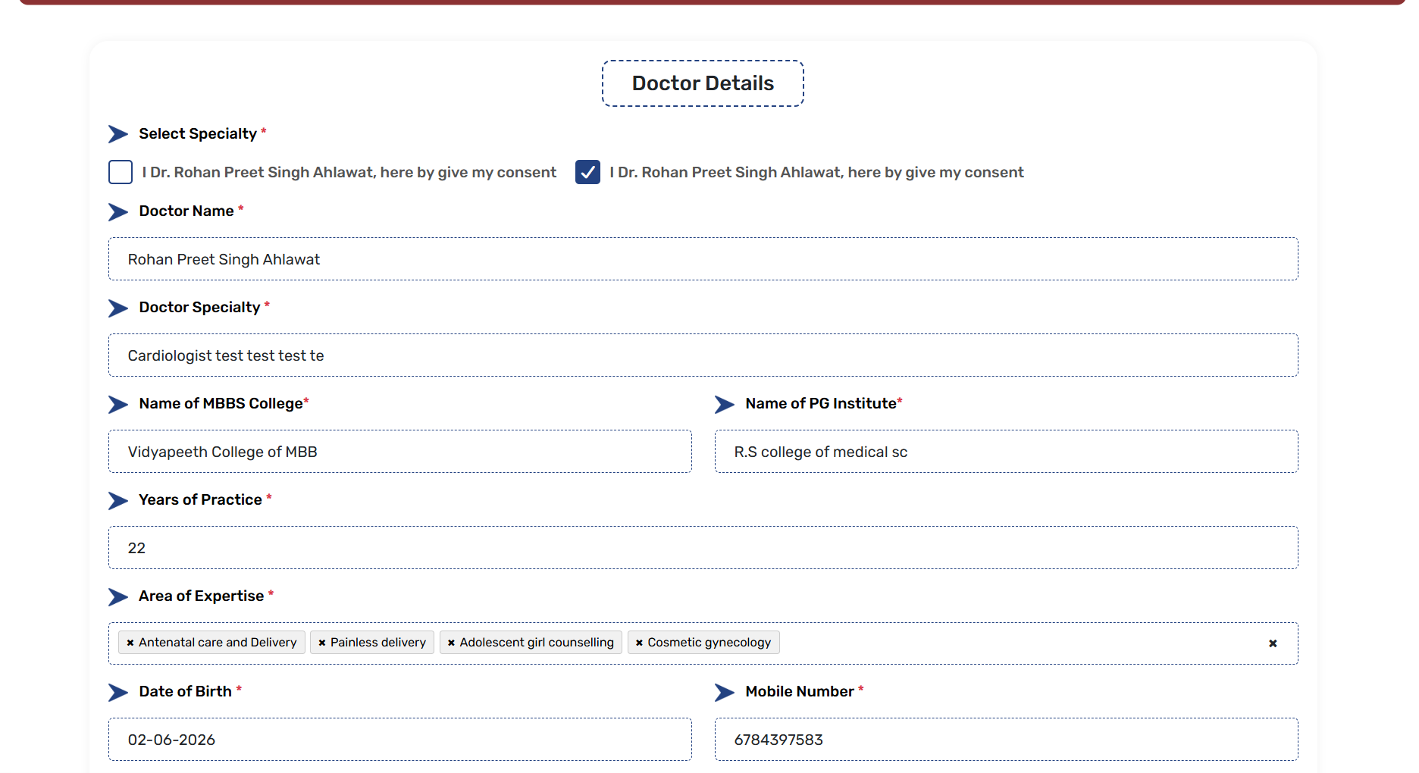

Slide 7
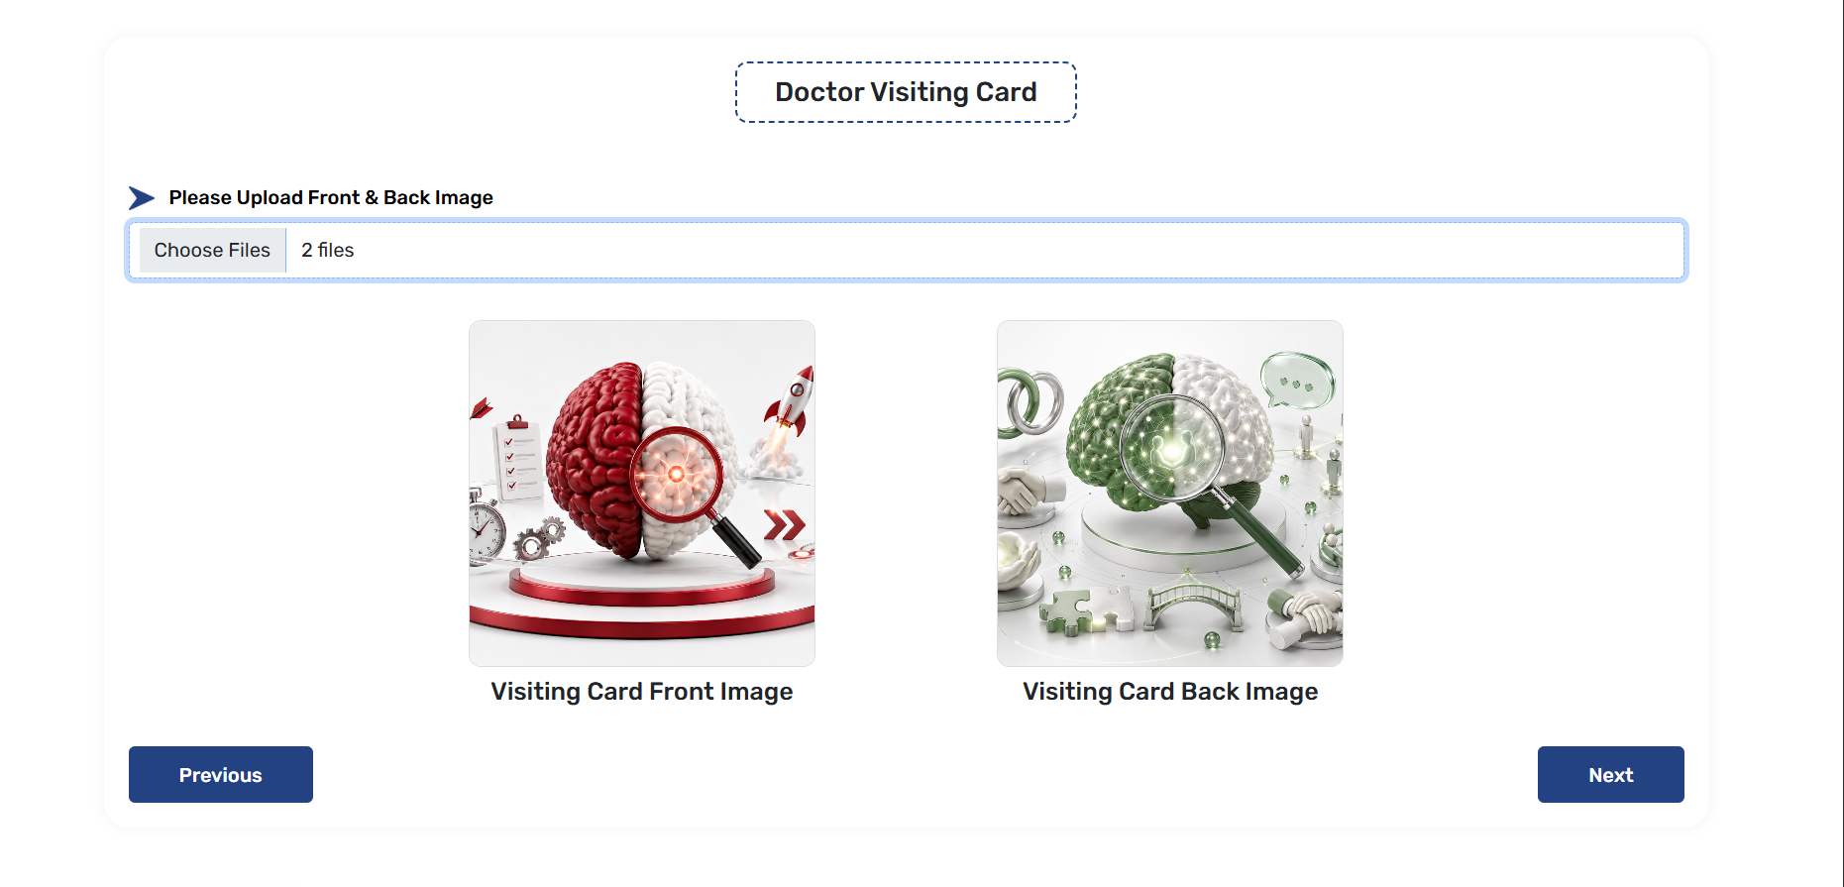
Is photo user capture karse to how will he upload.

Slide 8
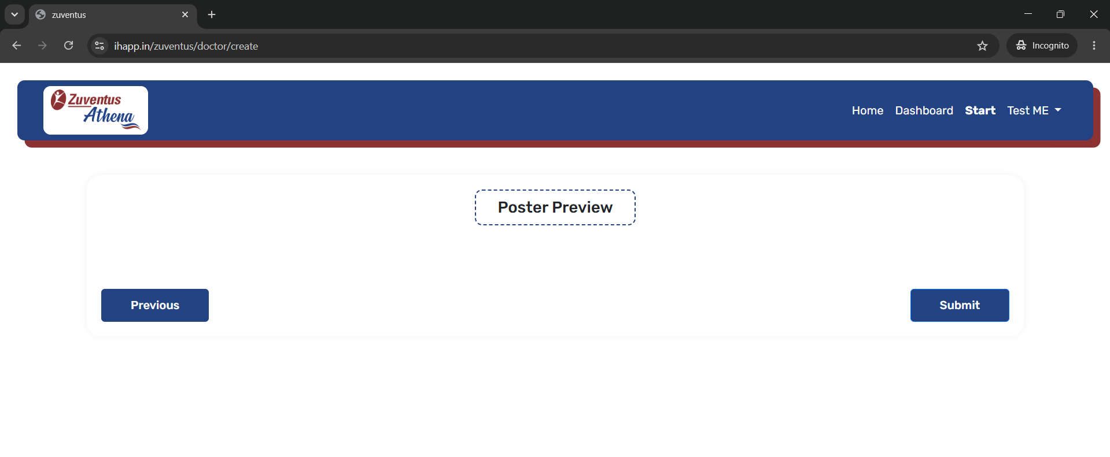
Poster preview not showing

Slide 9
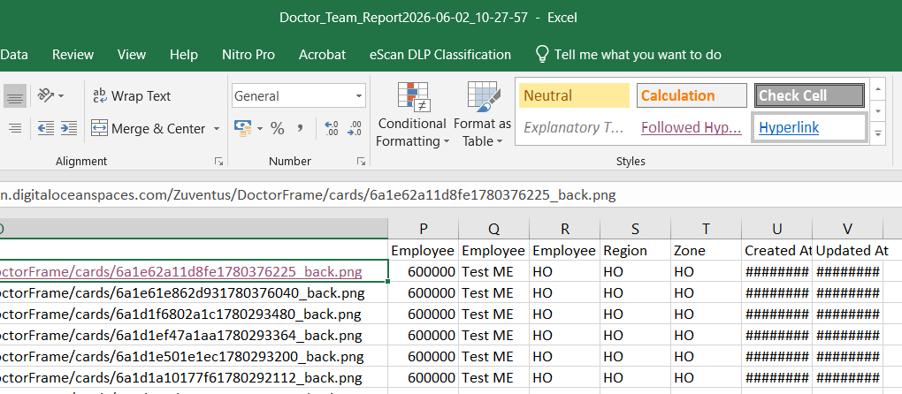

Journey_Frame_Report

Slide 10
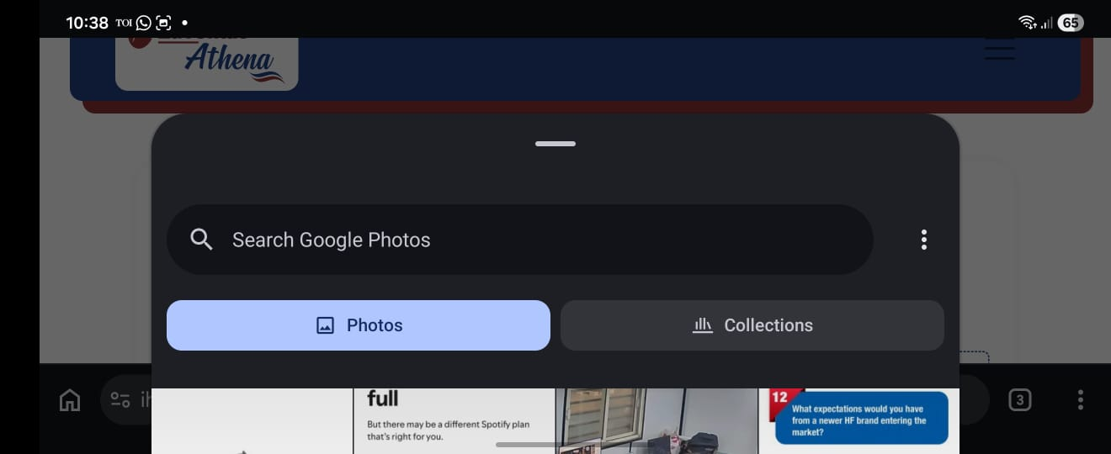
Pls give option to capture image in doctor photo and visiting card

Slide 11
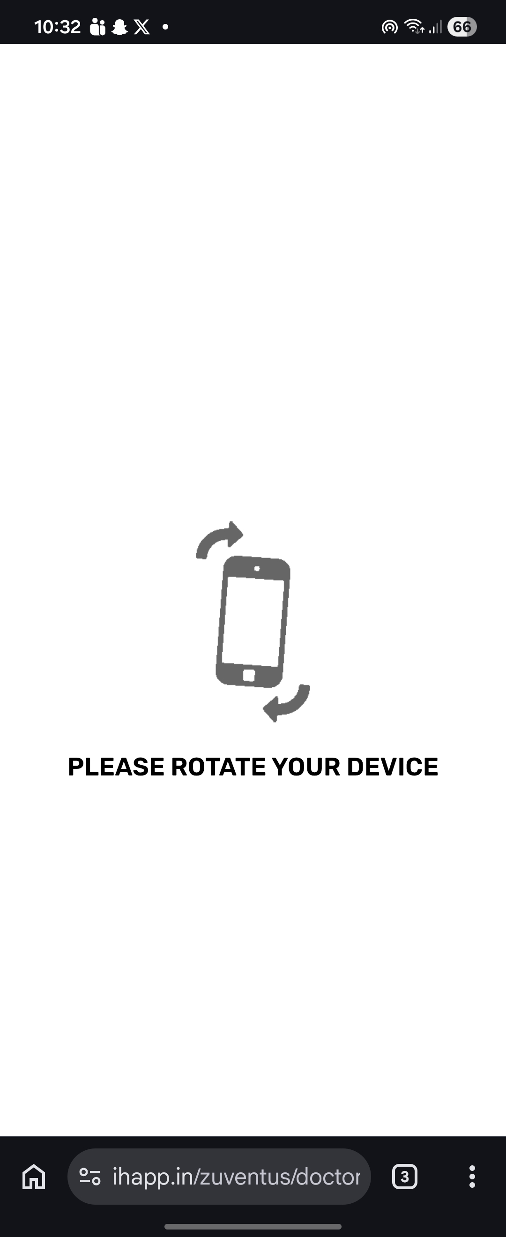
Please remove this should be able to enroll doctor in portrait mode

